Slide 1
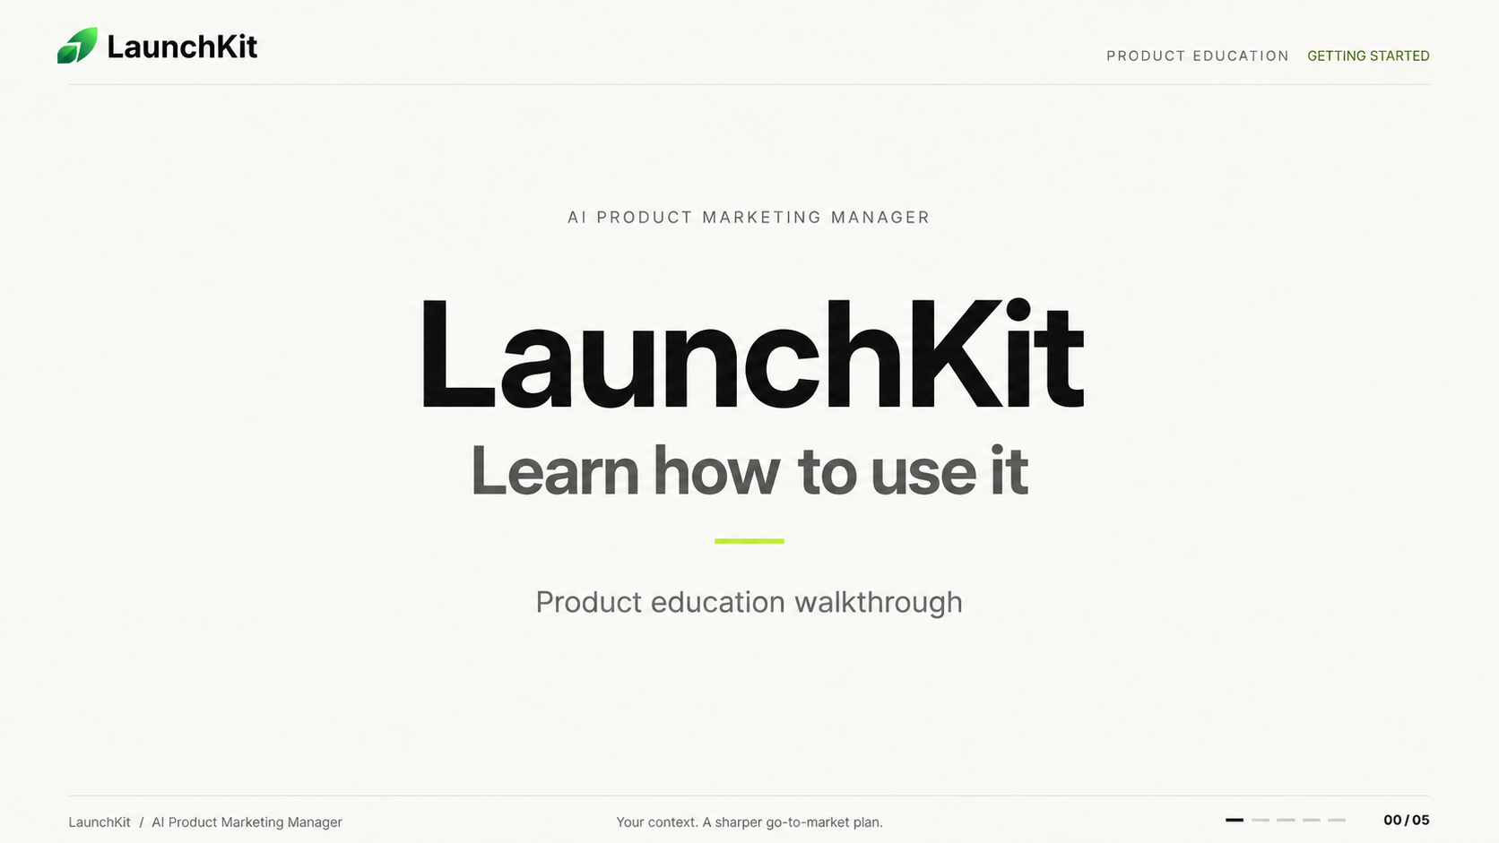
Notes:
LaunchKit product education cover slide. The approved design is preserved as a full-slide image; individual text and design elements are not editable.

Slide 2

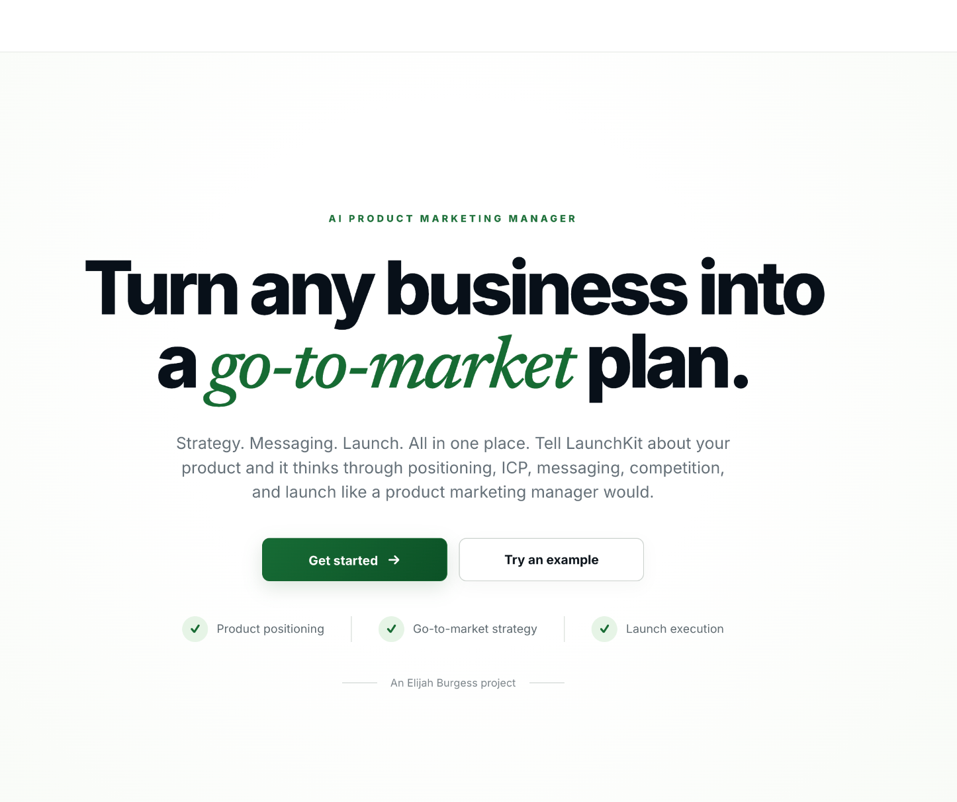
LaunchKit
GETTING STARTED
THE PRODUCT
Turn business context into a GTM plan
LaunchKit helps turn what you know about
your business into positioning, messaging,
launch strategy, and sales-ready outputs.
Your Business
LaunchKit
Your GTM
Strategy
ICP • Positioning • Messaging • Launch • Sales
You don’t need to know how to prompt AI.
LaunchKit guides you through the process.
LaunchKit / AI Product Marketing Manager
Understand the product
01 / 05
Notes:
Learning objective: Explain what LaunchKit does in one sentence. Walk from the business context to a structured GTM plan. ICP means ideal customer profile; GTM means go-to-market. Emphasize that guided onboarding replaces the blank-prompt starting point.
Screenshot placement: Select the light-gray placeholder image and use Change Picture to replace it with a real capture. Keep the captured interface readable; crop only unused margins. Labels, arrows, and other teaching callouts are separate editable objects. Move callout endpoints to the real controls or fields after the capture is inserted. Do not read the gray screenshot labels to the audience.
Capture suggestion: Use the real landing page or a broad, uncluttered view of the main product experience. The three teaching cards are a conceptual diagram, not product UI.
Sources: User-provided education brief. Product workflow: https://github.com/ElijahJBurgess/LaunchKit-/blob/main/README.md . Palette: https://github.com/ElijahJBurgess/LaunchKit-/blob/main/src/styles/global.css . Repository checked September 18, 2026. Screenshot source: https://launchkitpmm.vercel.app/ .

Slide 3
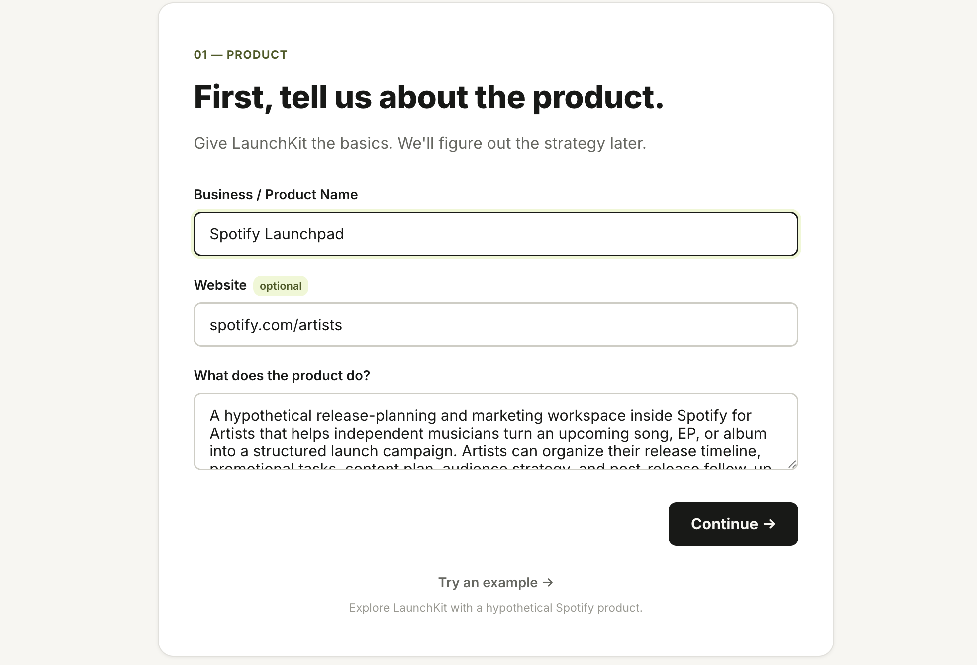
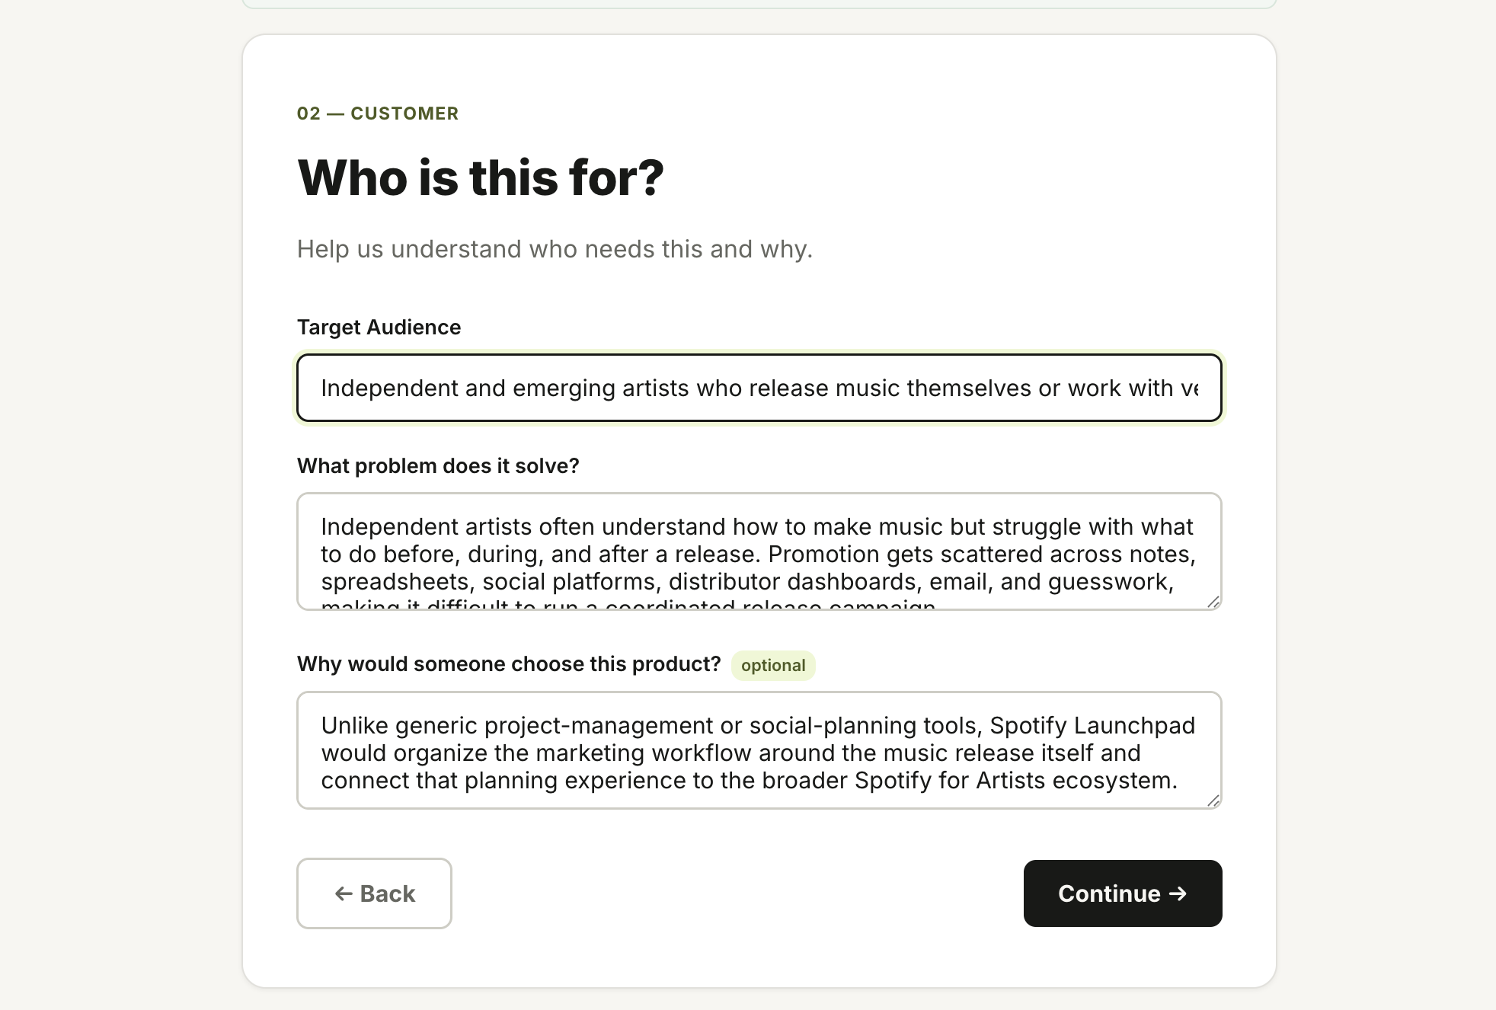
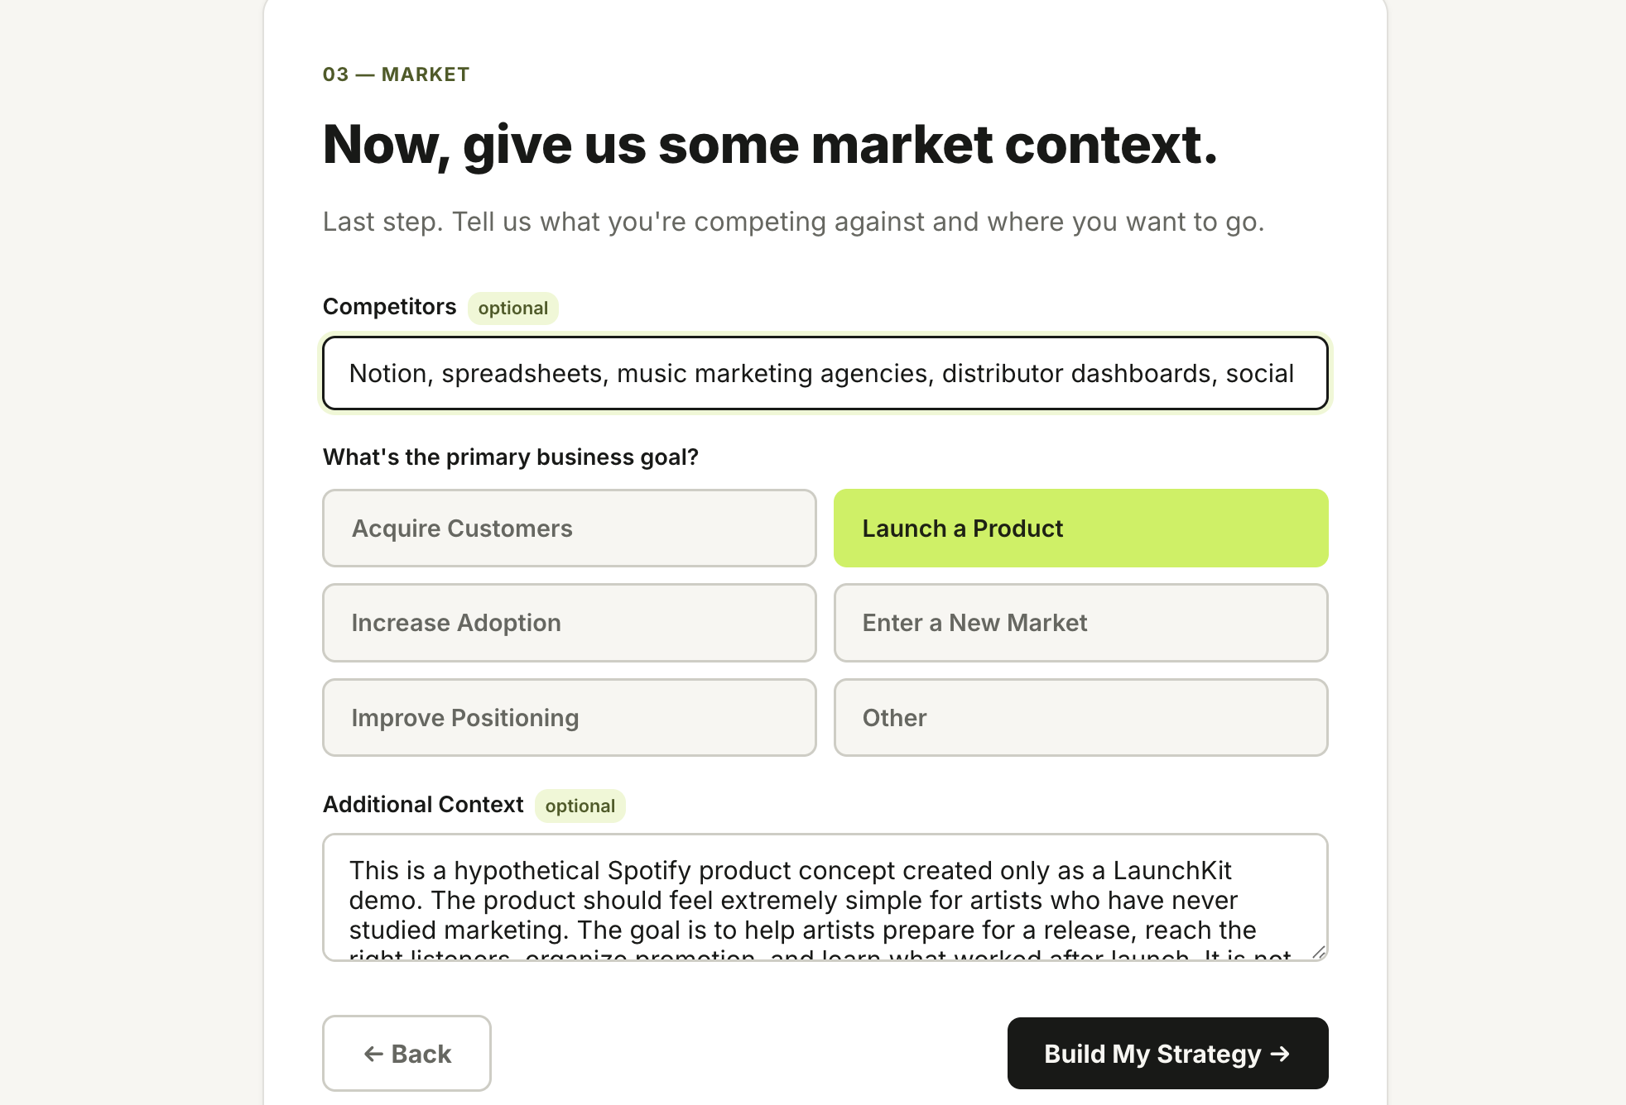
LaunchKit
PRODUCT EDUCATION
GETTING STARTED
Step 1: Tell LaunchKit what you’re building
LaunchKit works best when you give it clear business context.
1
Explain the product
2
Define the customer
3
Add the goal
What are you building?
Who is it for and what
problem do they have?
What are you trying
to achieve?
Better context leads to better strategy.
LaunchKit / AI Product Marketing Manager
Add business context
02 / 05
Notes:
Learning objective: Know which information to prepare before generating a strategy. Explain the product, define the customer and their problem, and add the business goal. The actual onboarding stages are Product, Customer, and Market + Goal.
Screenshot placement: Select the light-gray placeholder image and use Change Picture to replace it with a real capture. Keep the captured interface readable; crop only unused margins. Labels, arrows, and other teaching callouts are separate editable objects. Move callout endpoints to the real controls or fields after the capture is inserted. Do not read the gray screenshot labels to the audience.
Capture three real onboarding screens in order. A crop centered on each form will be more readable than a full-page browser capture. Do not enter invented customer evidence.
Sources: User-provided education brief. Product workflow: https://github.com/ElijahJBurgess/LaunchKit-/blob/main/README.md . Palette: https://github.com/ElijahJBurgess/LaunchKit-/blob/main/src/styles/global.css . Repository checked September 18, 2026. Screenshot source: https://launchkitpmm.vercel.app/ .

Slide 4
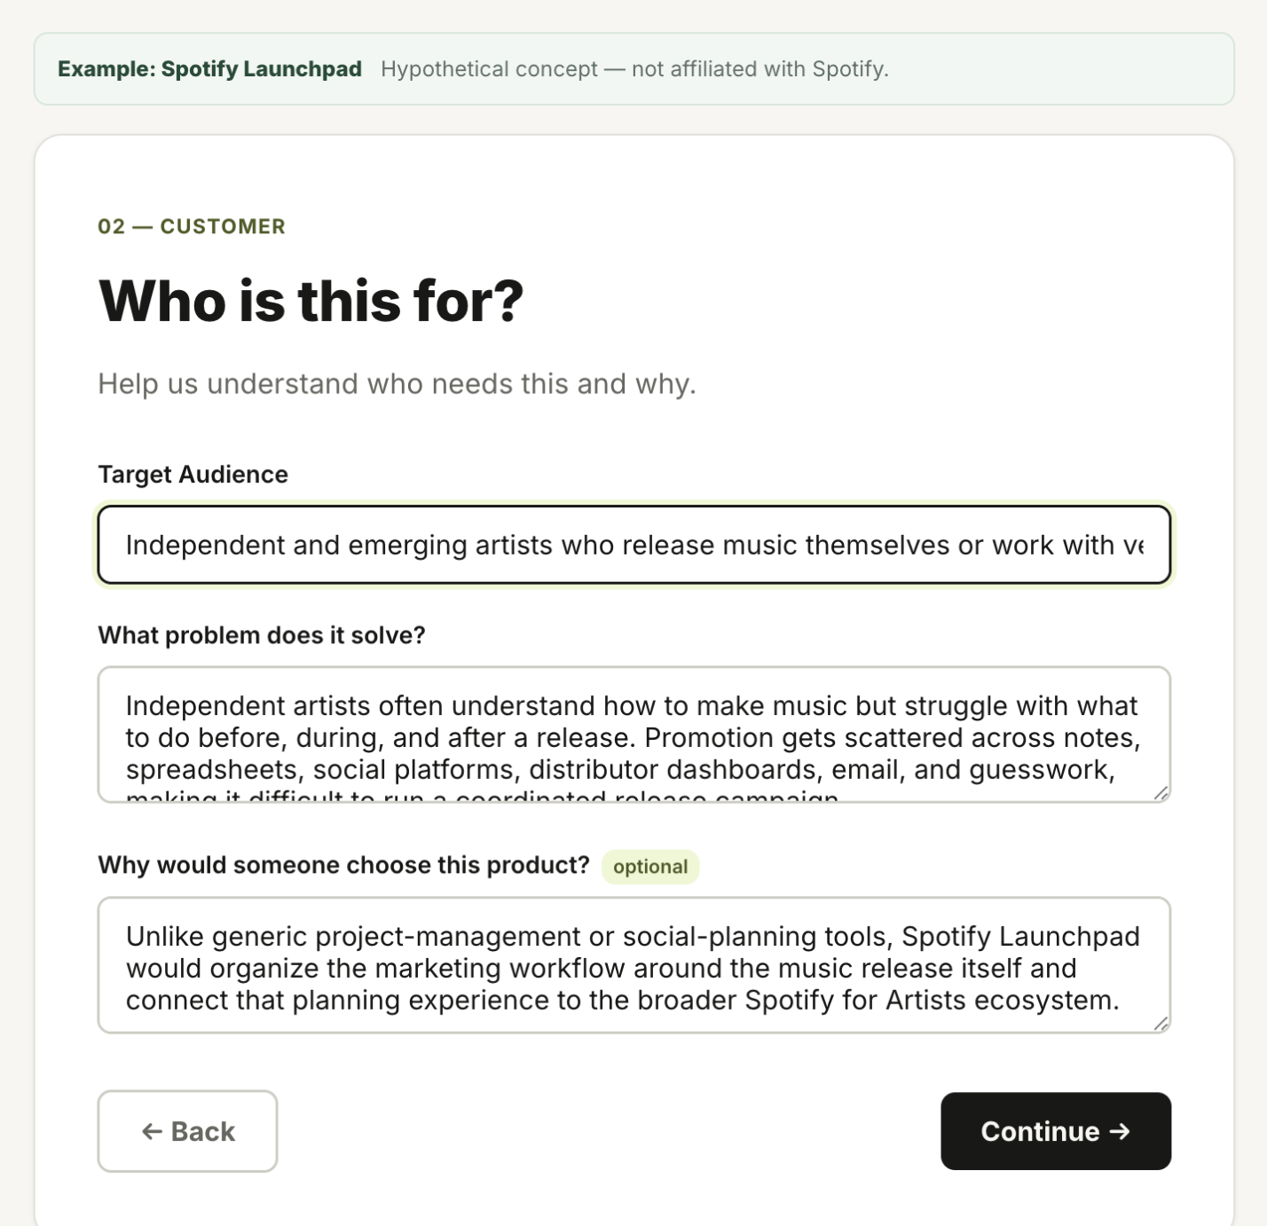
LaunchKit
PRODUCT EDUCATION
GETTING STARTED
Step 2: Give AI something
useful to work with
FOCUS ON THREE FIELDS
1
Customer
2
Problem
3
Context
WEAK
BETTER
We make software
for businesses.
We help small event organizers sell
tickets, manage attendees, and check
guests in without needing multiple tools.
Be specific about the customer
Avoid saying “everyone.”
Explain the real problem
Describe what makes the user’s job difficult today.
Add useful context
Competitors, goals, differentiation, and business stage all help.
LaunchKit can organize the strategy, but the quality
of the starting context still matters.
LaunchKit / AI Product Marketing Manager
Improve your inputs
03 / 05
Notes:
Learning objective: Distinguish vague business context from useful context. Compare the weak software description with the more specific event-organizer example. This is a sample input, not a claim about LaunchKit customers or results.
Screenshot placement: Select the light-gray placeholder image and use Change Picture to replace it with a real capture. Keep the captured interface readable; crop only unused margins. Labels, arrows, and other teaching callouts are separate editable objects. Move callout endpoints to the real controls or fields after the capture is inserted. Do not read the gray screenshot labels to the audience.
Capture an actual business-input screen. The three numbered field labels are editable teaching annotations, not invented input fields. After replacing the screenshot, move them and their arrows to the real customer, problem, or context fields that are visible.
Sources: User-provided education brief. Product workflow: https://github.com/ElijahJBurgess/LaunchKit-/blob/main/README.md . Palette: https://github.com/ElijahJBurgess/LaunchKit-/blob/main/src/styles/global.css . Repository checked September 18, 2026. Screenshot source: https://launchkitpmm.vercel.app/ .

Slide 5
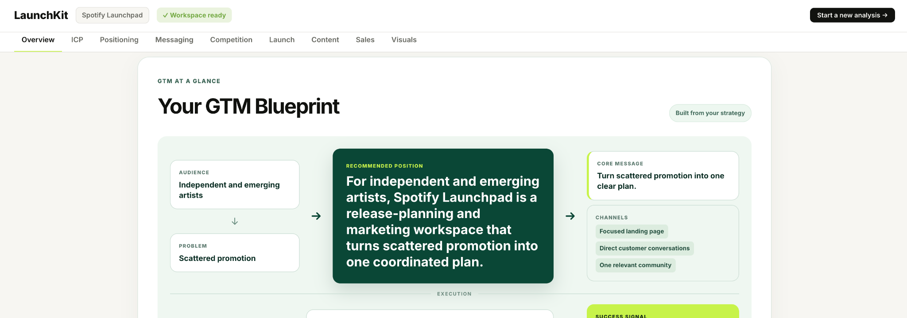
LaunchKit
PRODUCT EDUCATION
GETTING STARTED
Step 3: Explore your strategy
Each section uses the same underlying business context, so the strategy stays connected.
Business Context
GTM Blueprint
Priority Actions
90-Day Roadmap
KPIs
ICP
Positioning
Messaging
Launch
Sales
LaunchKit / AI Product Marketing Manager
Explore your strategy
04 / 05
Notes:
Learning objective: Navigate the strategy as connected sections rather than a long AI report. Use the workspace overview and GTM Blueprint as the entry point, find the top priorities, and explore the other sections. The vertical chain is a teaching sequence, not a claim that the backend generates sections serially.
Screenshot placement: Select the light-gray placeholder image and use Change Picture to replace it with a real capture. Keep the captured interface readable; crop only unused margins. Labels, arrows, and other teaching callouts are separate editable objects. Move callout endpoints to the real controls or fields after the capture is inserted. Do not read the gray screenshot labels to the audience.
Capture the real strategy workspace. Reposition the four numbered labels to the actual entry point, navigation, priority area, and section-level Regenerate control. Regeneration is supported per section; it does not require regenerating the whole strategy. Scores are heuristic indicators, not measured business performance.
Sources: User-provided education brief. Product workflow: https://github.com/ElijahJBurgess/LaunchKit-/blob/main/README.md . Palette: https://github.com/ElijahJBurgess/LaunchKit-/blob/main/src/styles/global.css . Repository checked September 18, 2026. Screenshot source: https://launchkitpmm.vercel.app/ .

Slide 6
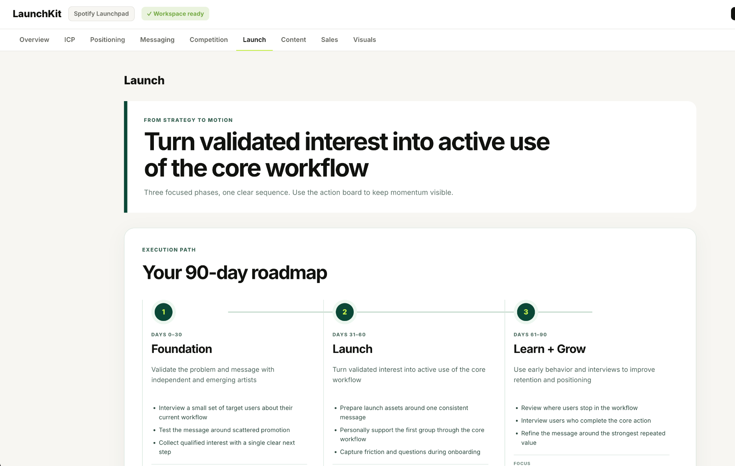
LaunchKit
PRODUCT EDUCATION
GETTING STARTED
Your strategy is a starting point
FROM PLAN TO ACTION
Review it
Make sure it reflects what you know
about your customer.
?
Challenge it
Don’t accept every AI recommendation
automatically.
Edit it
Adjust messaging, positioning, and
tactics to fit your business.
Use it
Turn the strategy into launch plans,
sales messaging, content, and creative.
Good to know
AI can still be wrong
Unverified assumptions should be checked
Better inputs usually create better outputs
Strategy should improve as you learn more about customers
Use LaunchKit to move faster — not to stop thinking.
LaunchKit / AI Product Marketing Manager
Put the strategy to work
05 / 05
Notes:
Learning objective: Turn AI-assisted strategy into informed action. Review the plan against what you know, challenge assumptions, adapt the outputs, and use them in real work. AI output is not verified customer or competitor research.
Screenshot placement: Select the light-gray placeholder image and use Change Picture to replace it with a real capture. Keep the captured interface readable; crop only unused margins. Labels, arrows, and other teaching callouts are separate editable objects. Move callout endpoints to the real controls or fields after the capture is inserted. Do not read the gray screenshot labels to the audience.
Capture one final useful output: GTM Blueprint, 90-Day Roadmap, Sales, or Visuals. Editing here means adapting the strategy and draft content; do not imply a specific inline editor that is not shown. Copy or export the content into your working tools as needed. If demonstrating Visuals, explain that visual generation is optional and user-triggered, separately from strategy generation.
Sources: User-provided education brief. Product workflow: https://github.com/ElijahJBurgess/LaunchKit-/blob/main/README.md . Palette: https://github.com/ElijahJBurgess/LaunchKit-/blob/main/src/styles/global.css . Repository checked September 18, 2026. Screenshot source: https://launchkitpmm.vercel.app/ .

